Slide 1
THE LANGUAGE OF PHOTOGRAPHY
“reading photographs”

Slide 2
A PICTURE MUST TELL A STORY
CLUES ABOUT:
Character
Context/setting
Conflict
Must be contained in one picture
See if you can “tell the story” contained in these photographs

Slide 3
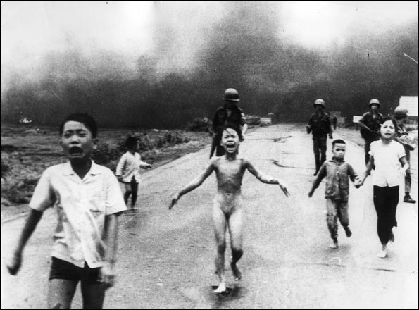

Slide 4
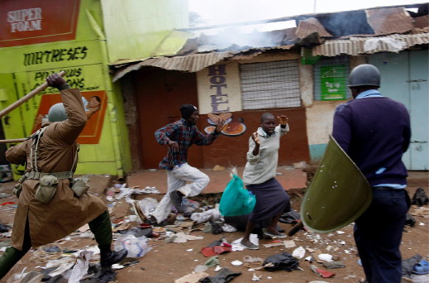

Slide 5
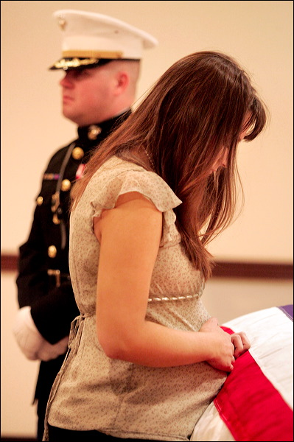

Slide 6
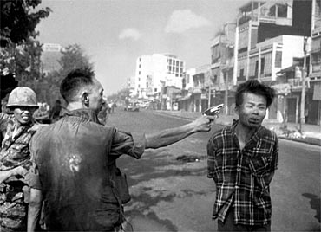

Slide 7
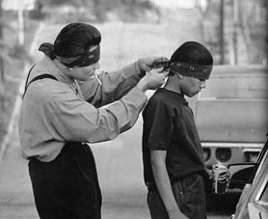

Slide 8
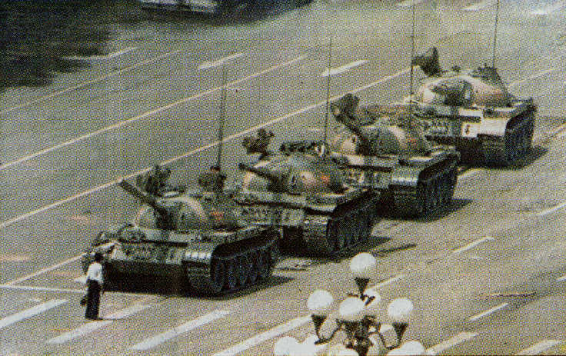

Slide 9
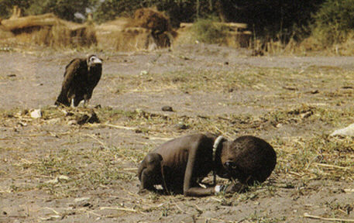

Slide 10
BACKGROUND INFO
A vulture watches a starving child [1993]
Kevin Carter’s winning photo shows a heart-breaking scene of a starving child collapsed on the ground, struggling to get to a food center during a famine in the Sudan in 1993. In the background, a vulture stalks the emaciated child.
Carter was part of a group of four fearless photojournalists known as the “Bang Bang Club” who traveled throughout South Africa capturing the atrocities committed during apartheid.
Haunted by the horrific images from Sudan, Carter committed suicide in 1994 soon after receiving the award.”

Slide 11
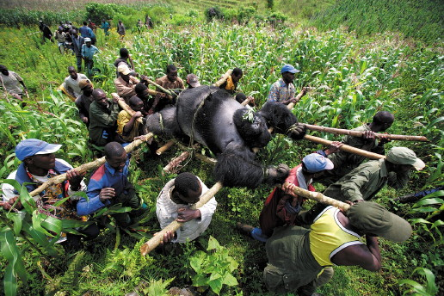

Slide 12
There are some basic techniques used to make THE COMPOSITION (arrangement of elements) of photographs more effective

Slide 13
FRAMING
What is FRAMING?
Framing does not refer to physical frames you put your photos into
Framing is a technique used to enhance the overall result of a photo and to draw attention to the subject.
It consists of using natural or man-made objects within the photo itself
Framing doesn’t have to be used in a specific way to get great results.
A frame doesn’t necessarily need to completely surround the subject, nor does it need to be in the foreground

Slide 14
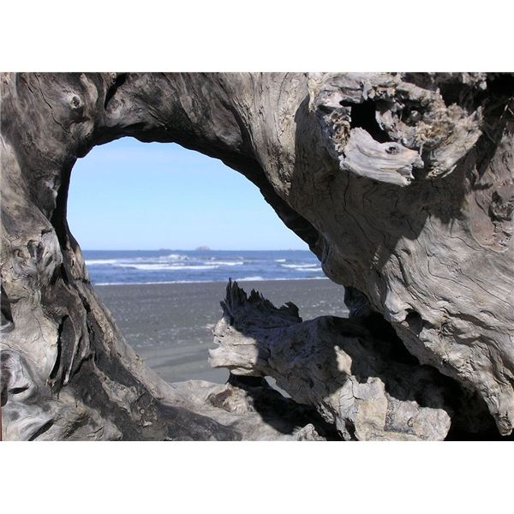

Slide 15
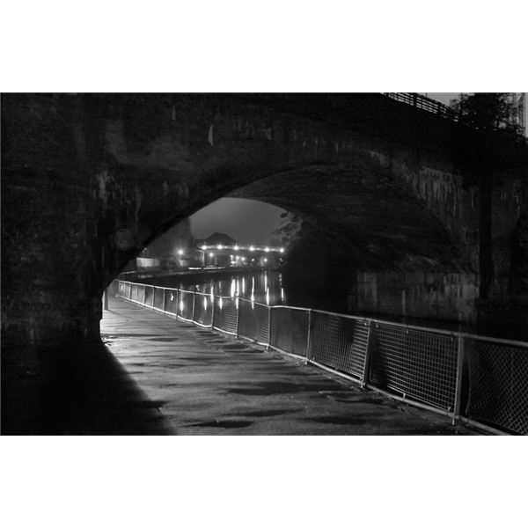

Slide 16
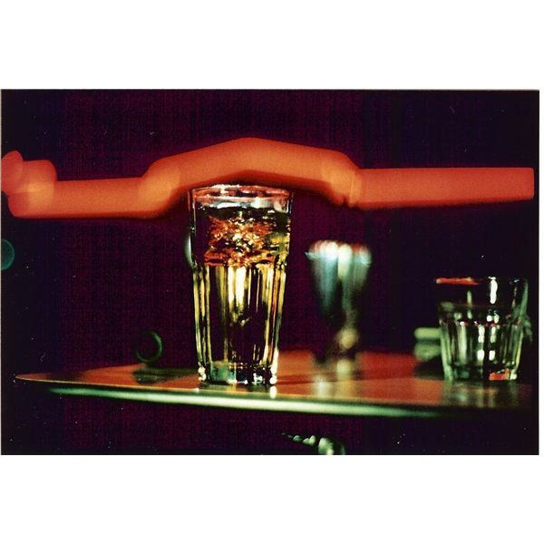

Slide 17
USING LINES
In photography, the use of lines can have significant impact
Making use of lines in photography is a photographic composition technique used by many professional photographers.
Lines - also referred as “Leading Lines” - can be used to lead the eye to the point of interest and prevent the eye from wandering.
Lines can put emphasis on distance or illustrate a relationship to foreground and background elements.

Slide 18
LINES
Vertical Lines
Vertical lines can suggest dominance, power and growth. Some excellent examples include tall structural designs and trees.

Slide 19
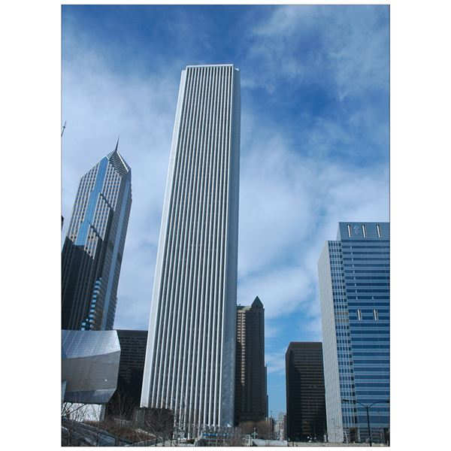

Slide 20
LINES contd.
Horizontal Lines
Horizontal lines can suggest peace, calmness and a sense of restfulness. Some prime examples include fallen trees, the ocean, beaches and horizons.
Just like vertical lines, horizontal lines should be kept as horizontal as possible.
Layering horizontal lines can strengthen the composition and can be successful in generating patterns and rhythm.

Slide 22
More lines
Diagonal Lines
Diagonal lines can suggest action, stimulation and depth.
The use of diagonal lines can help draw the eye through a photo.
The best way to utilize diagonal lines is to present them from the bottom left of the photo to the top right, this is because our eyes naturally scan from left to right.
To prevent the photo from looking split, try positioning your diagonal lines to begin slightly above or below the corner of the photo.

Slide 23
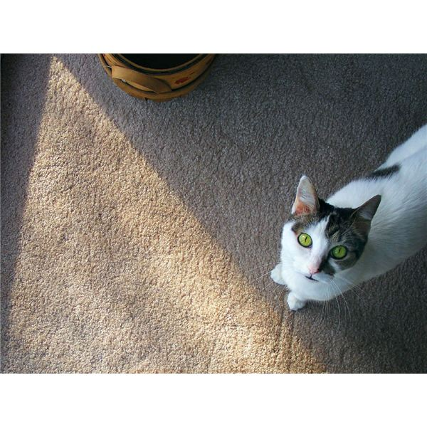

Slide 24
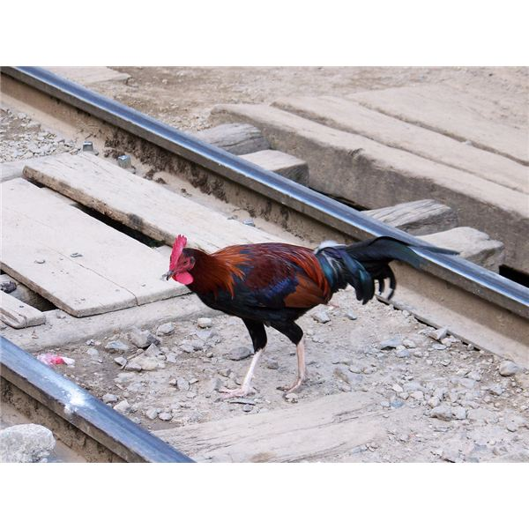

Slide 25
Lines contd.
Curved Lines or S Curves
Curved lines or S curves suggest sensuality, elegance and a serene sense of balance.
S curves don’t necessarily need to be S-shaped; any form of a winding line can be used.
Some examples include rivers, streams, paths and even the human body.

Slide 26
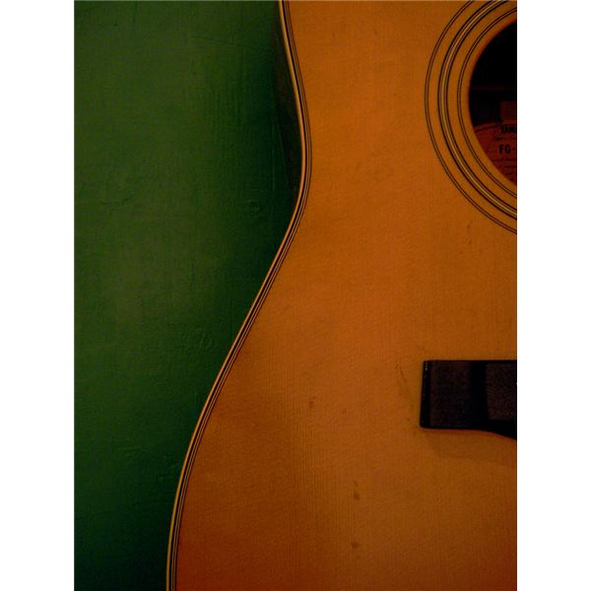

Slide 27
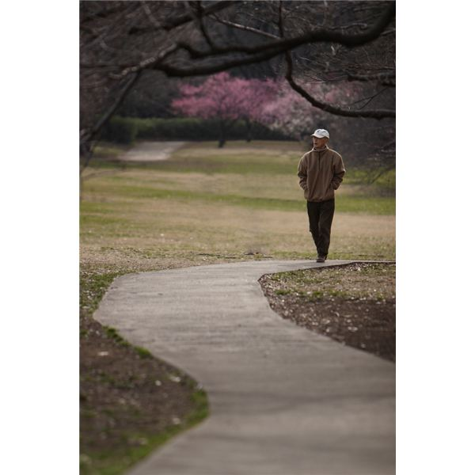

Slide 28
lines
Converging Lines
Converging lines will add a certain flow or depth to your photograph.
It will also add a sense of distance or scale.
Some examples of converging lines are power lines, stairways and the infamous railroad tracks.
Our eyes are naturally drawn to where intersecting lines connect. To create a stronger impact and visual interest, it’s best to position your subject near converging lines.
However, sometimes converging lines are point of interest in itself and there is no need for additional subjects.

Slide 29
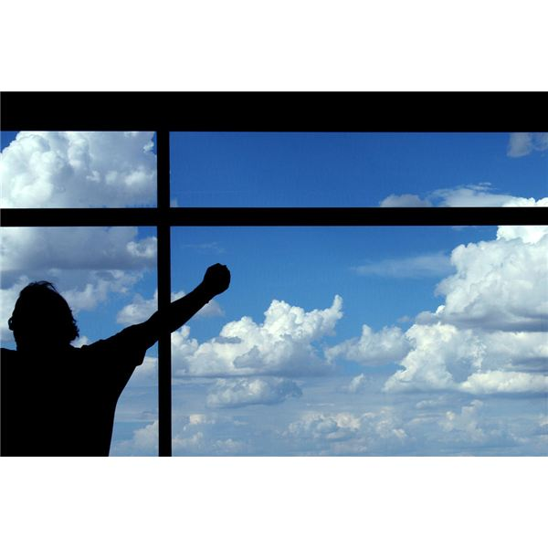

Slide 30
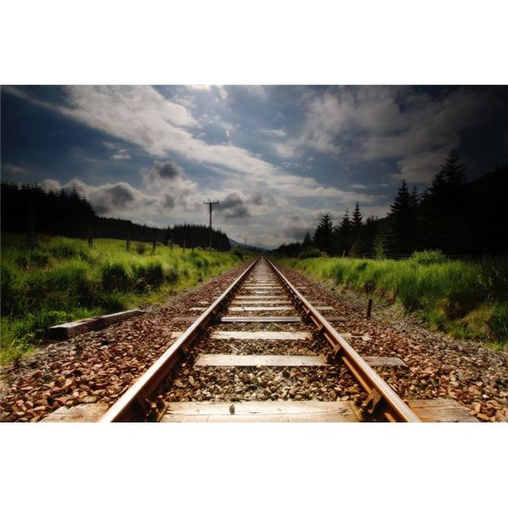

Slide 31
Rule of Thirds
Visualize a Tic-Tact-Toe grid and you’ve pictured the Rule of Thirds.
The idea is that you take your subject(s) or areas of interest and place them along or near the intersecting parts of the grid.

Slide 32
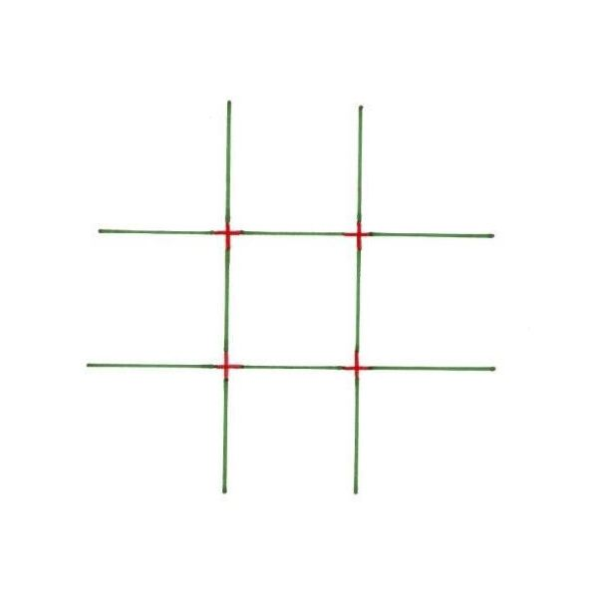

Slide 33
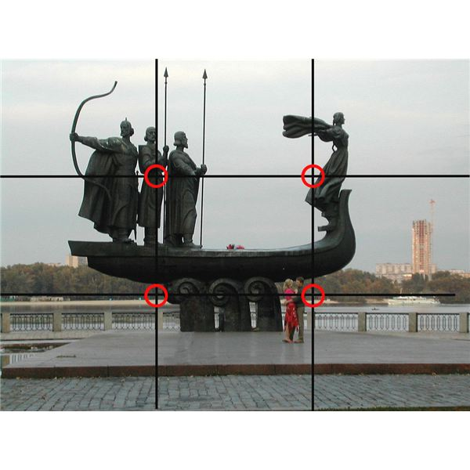

Slide 34
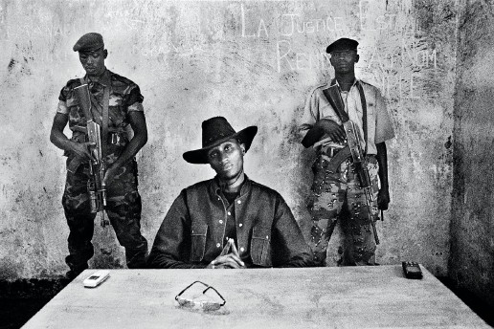

Slide 35
IN GROUP SHOTS
No two sets of eyes on the same level

Slide 37
FILL THE FRAME
Get up close and personal
Filling the frame with the point of interest
-eliminates background distractions,
- creates intimacy
- ensures important details are clear
- Gives the picture a focal point Move subject away from centre of frame and to the edges

Slide 38
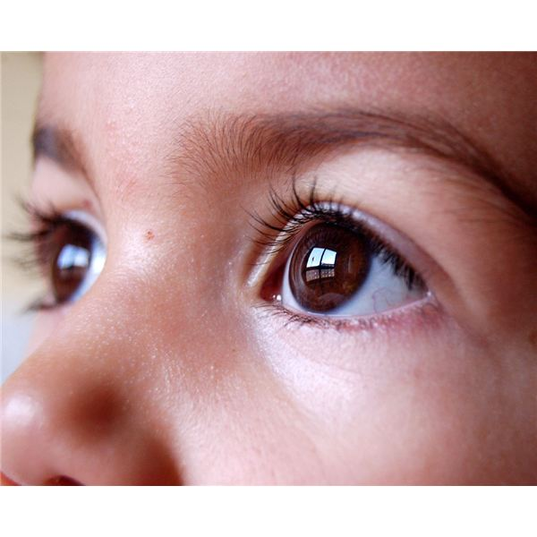

Slide 39
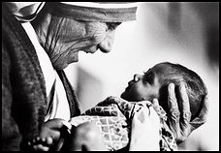

Slide 40
CONTRAST
HIGH AND LOW CONTRAST.
high contrast will create a vibrant, solid and loud image that will steal the attention of the viewer.
Low contrast will produce a warm and soft image, creating a soothing or mellow image.
In colour photography, OPPOSITE COLOURS create a higher contrast

Slide 41
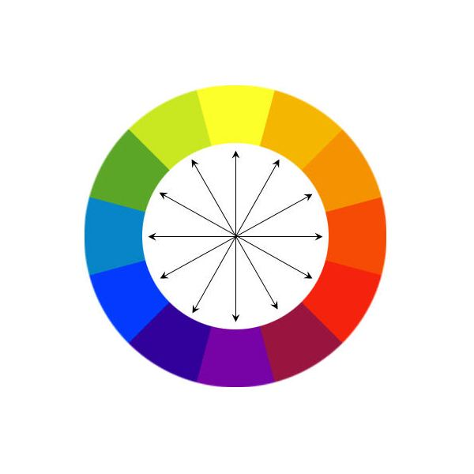

Slide 42
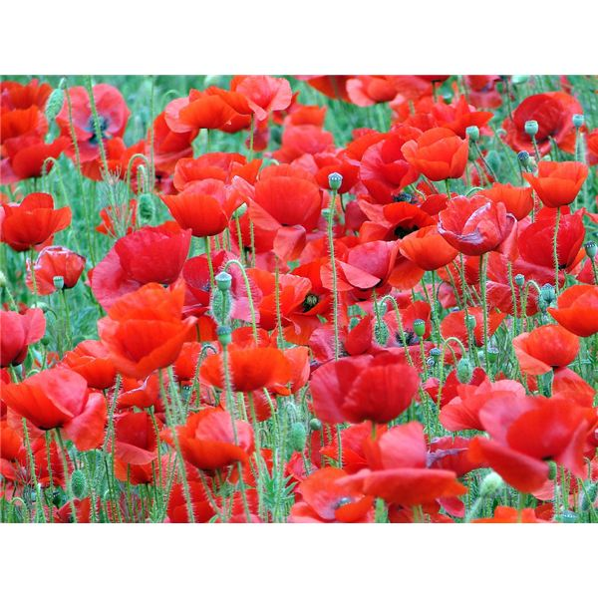

Slide 43
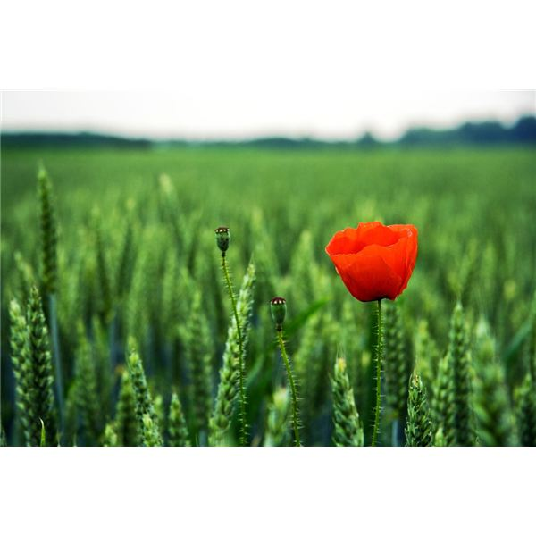

Slide 44
EXPLORE DIFFERENT ANGLES
Shoot from other than your eye level
Using other VANTAGE POINTS gives a whole different perspective; ex photos taken from below the subject make it appear bigger/superior.
The opposite applies to photos taken from above
Experiment shooting from different/creative angles (below, above, inside, outside)

Slide 45
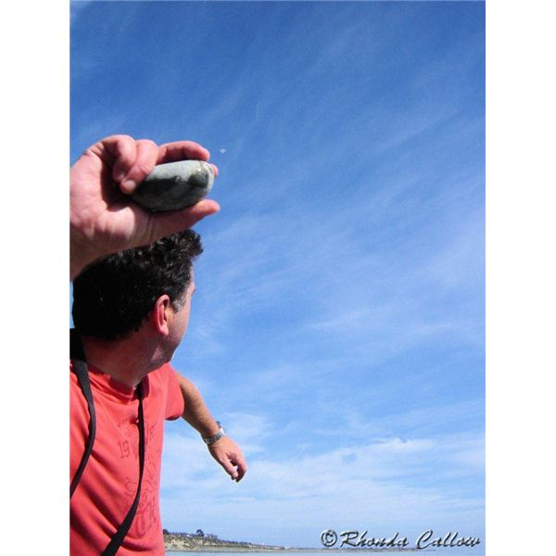

Slide 46
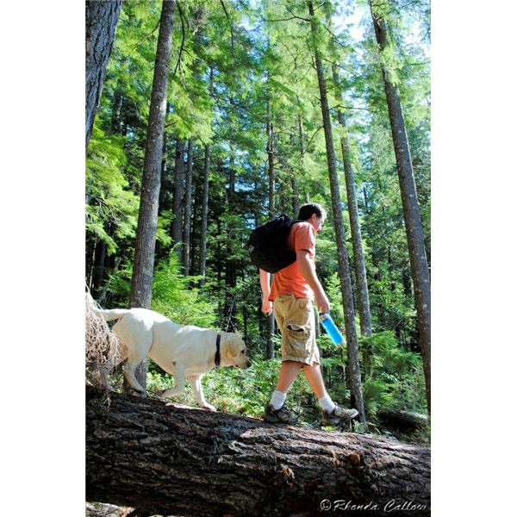

Slide 47
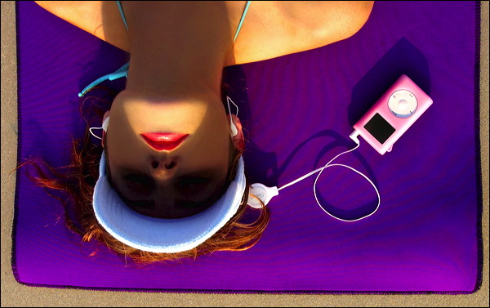

Slide 48
SETTING
Give clues that tell where you took the picture
Clues can appear in foreground and background
Trim away excess background so that only the essence of the place remains

Slide 49
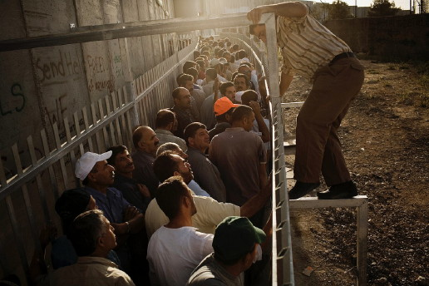

Slide 50
Analyze all techniques used in these photos

Slide 51
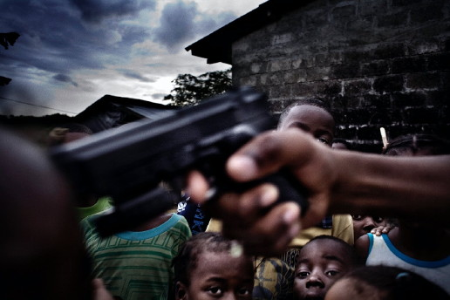

Slide 52
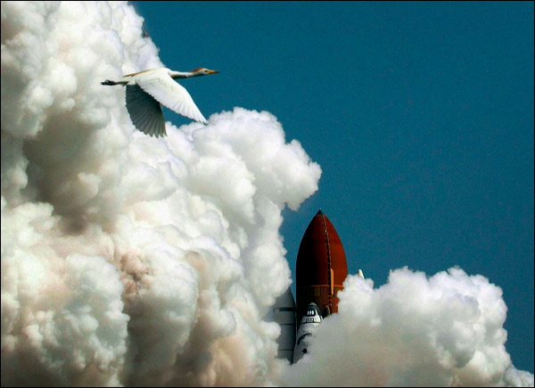

Slide 53
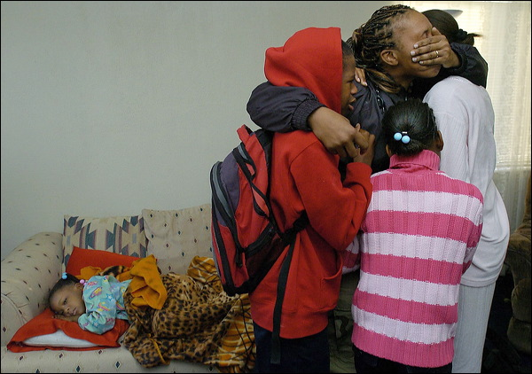

Slide 54
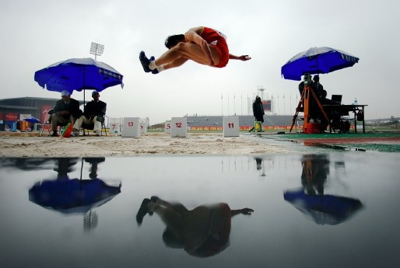

Slide 55
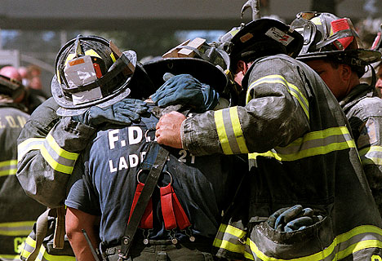

Slide 56
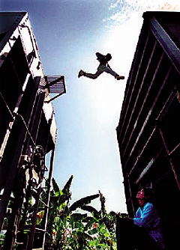

Slide 57
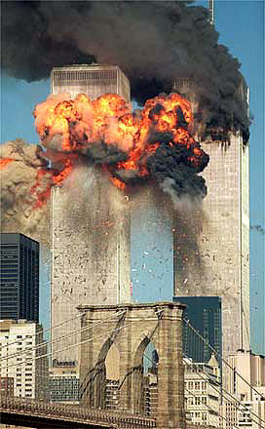

Slide 58
