Slide 1
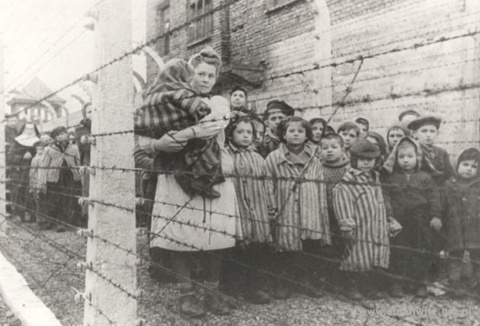
Auschwitz
Bethany & Lauren

Slide 2
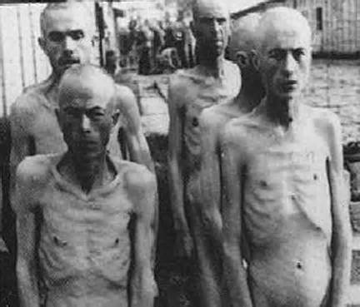
What is Auschwitz?
Largest concentration camp established by the Nazi regime
Labor camp and killing centre
1.1 million people killed

Slide 3
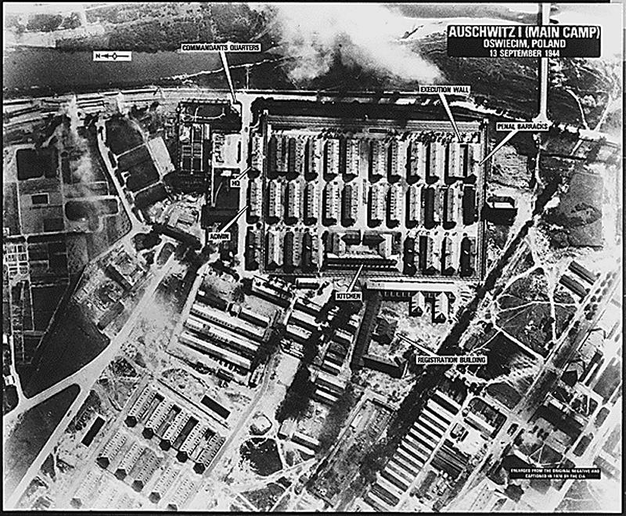
Camp layout
Began with Auschwitz I, expanded to 3 camps and 44 subcamps
4 large gas chambers

Slide 4
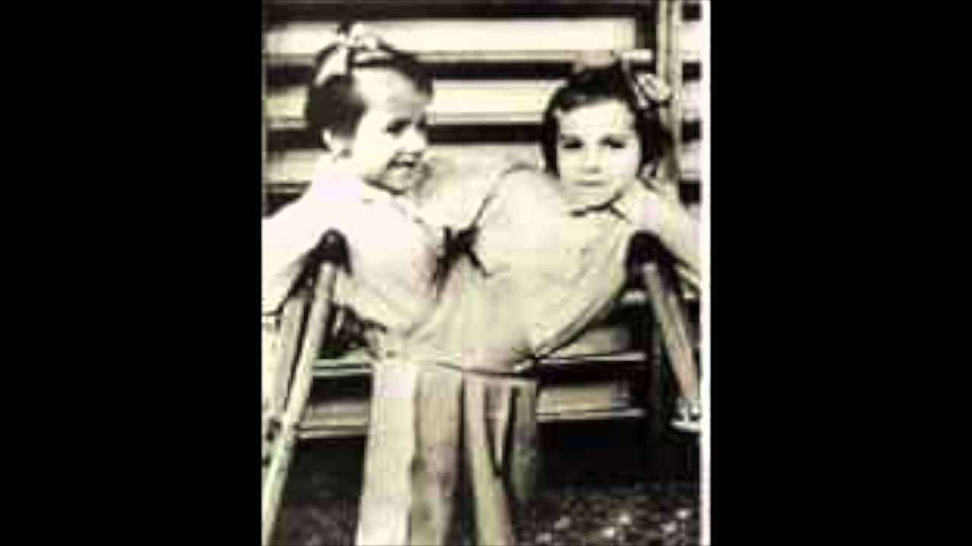
Life at Auschwitz
Pseudoscientific experiments
All their belongings were confiscated
Worked until they were deemed too ill

Slide 5
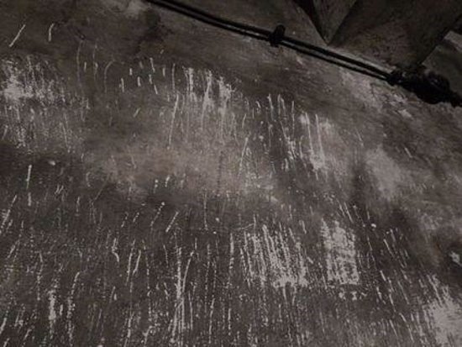
Prisoner uprising
Took place on October 7th, 1944
Prisoners blew up gas chambers and adjacent crematorium
Killed guards

Slide 6
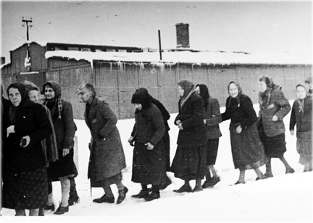
Prisoner march
Soviets approaching to liberate camp
SS guards forced prisoners to walk 63 kilometers
Anyone who fell behind was killed
Suffered from starvation and exhaustion in extremely low temperatures
15,000 prisoners died
Loaded onto unheated freight trains for many days without food, water, or blankets
7,000 prisoners left at Auschwitz

Slide 7
https://www.bing.com/videos/search?q=auschwitz+youtube&qpvt=auschwitz+youtube&view=detail&mid=4572A9A1540212CBD1164572A9A1540212CBD116&FORM=VRDGAR

